Slide 1

MICROPROCESSORS AND MICROCONTROLLERS (BECE204L)
DR. NAUSHAD MANZOOR LASKAR
ASSISTANT PROFESSOR SG-1
SCHOOL OF ELECTRONICS ENGINEERING (SENSE)
VELLORE INSTITUTE OF TECHNOLOGY, VELLORE

Slide 2
MOTIVATION OF THE COURSE
Introduction to the concept of Microprocessors & Microcontrollers
Familiarization with the architectures of various conventional and state of the art Microprocessors & Microcontrollers such as Intel, ARM etc.
Familiarization with assembly language programming, concept and implementation of interfacing with peripherals & I/O devices
Development of various applications using microprocessors such as ARM

Slide 3
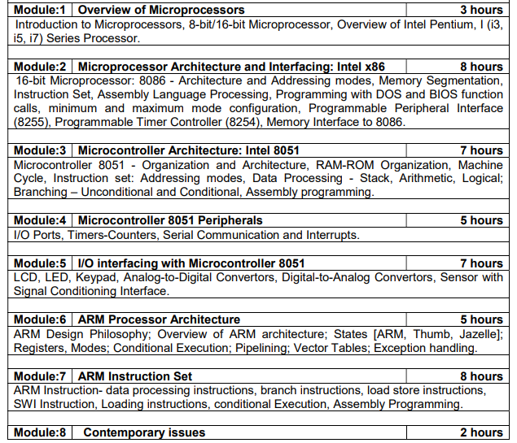
COURSE CONTENTS & LECTURE PLANNING
1
5
2
3
4

Slide 4
TENTATIVE ASSESMENT PLAN
Digital Assignment – 1 (10 MARKS)
Quiz-1 & Quiz-2 (20 MARKS)
NOTE: PROVISION TO OPT FOR A MINI RESEARCH PAPER STUDY PROJECT IN LIEU OF DA-1.
IN ADDITION TO CAT-1,CAT-2 AND FAT. SLOW LEARNERS TASK (MAX.-5 MARKS)
FOR LAB, 5 TASKS OF 12 MARKS EACH & LAB FAT
NOTE: PROVISION TO OPT FOR A MINI PROJECT IN LIEU OF TASK 4 & TASK 5 (24 MARKS)

Slide 5
Some Pre-requisites
Binary and Hexadecimal number system
Hexadecimal Number System: Following are the characteristics of a hexadecimal number system. Uses 10 digits and 6 letters, 0,1,2,3,4,5,6,7,8,9,A,B,C,D,E,F.
Letters represents numbers starting from 10. A = 10, B = 11, C = 12, D = 13, E = 14, F = 15. Also called base 16 number system.
a “Bit" is the smallest unit of storage and stores just a 0 or 1
1 Byte is group of 8 bits. 8 bits can make 256 different patterns
Flip-Flop can store 1 bit of information
A group of Flip-Flop is called Registers and can store n bits of information

Slide 6
MODULE 1: OVERVIEW OF MICROPROCESSORS

Slide 7
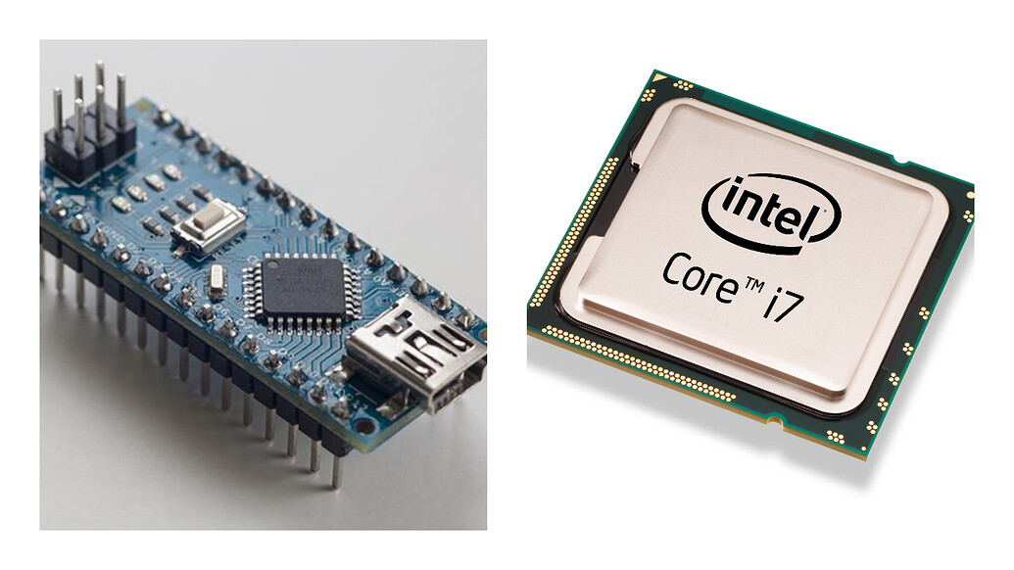
Introduction to Microprocessors
A Microprocessor is a programmable, multipurpose, clock -driven, register-based electronic device that reads binary instructions from a storage device called memory, accepts binary data as input and processes data according to those instructions and provides results as output.
Computer's Central Processing Unit (CPU) built on a single Integrated Circuit (IC) is called a microprocessor
A Microprocessor has many components like transistors, registers, and diodes which come together to perform. The ability of the chip has become more complex with technology evolution. The functionality has become better and the speed has become faster.
Most devices need to have a microprocessor to function. It is the element that brings intelligence to a device. Be it a computer or mobile phone, all devices need an interface to handle data that only a microprocessor provides.

Slide 8
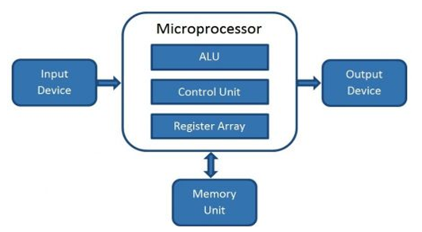
Generalized Block Diagram
controls the computer and performs all calculations.
ability to perform various operations quickly
ALU performs arithmetic and logical operations on the data received from an input device or memory
Communication through I/O Port/Bus
Register array consists of registers identified by letters like B, C, D, E, H, L, and accumulator.
Control unit controls the instructions and flow of data within the computer
stores programs and data required by the processor

Slide 9
Working of a Microprocessor
There are three steps that a microprocessor follows –
Fetch – The instructions are in storage from where the processor fetches them.
Decode – It then decodes the instruction to assign the task further. During this, the arithmetic and logic unit also performs to register the data temporarily.
Execute – The assigned tasks undergo execution and reach the output port in binary form.
Between these processes, the register stores the temporary data and ALU (Arithmetic and Logic Unit) performs the computing functions.

Slide 10
Memory
RAM − Random Access Memory is volatile memory that gets erased when power is switched off. All data and instructions are stored in RAM.
ROM − Read Only Memory is non-volatile memory whose data remains intact even after power is switched off. Microprocessor can read from it any time it wants but cannot write to it.
It is a processor in which memory and I/O output component is connected externally.

Slide 11
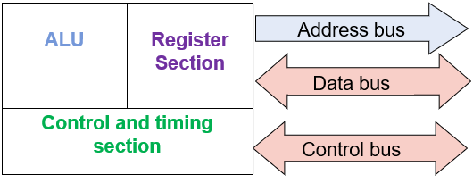
Basic Microprocessor Terms
Instructions Per Cycle – A way to measure CPU’s instruction speed in a single clock.
Instruction Set – These are the commands that a processor understands to work between hardware and software.
Bus – Set of conductors for data transmission, information control, and tasks addressed in a microprocessor. They are of three types – data bus, address bus, and control bus.
Word Length – Refers to the number of bits processed at a time.
Clock Speed / Clock Rate – The ability of microprocessors to perform tasks in a second.
Bandwidth – Refers to the total bits in a single instruction.
Data Types – Data type microprocessor supports like binary, ASCII, etc.
SIMD – Single Instruction Multiple Data
PGA – Pin Grid Array
FPU – Floating Point Unit
ALU – Arithmetic and Logic Unit
MMX – MultiMedia eXtensions
MMU – Memory Management Unit
Bit: Binary Digit

Slide 12
Evolution of Microprocesors
Transistor was invented in 1948 (23 December 1947 in Bell lab). IC was invented in 1958 (Fair Child Semiconductors) By Texas Instruments J Kilby. The first microprocessor was invented by INTEL(INTegrated ELectronics)
Name & Year | Bit Size | Description | Limitations/Improvements
4004 (1971) | 4 | 1st Microprocessor having 2300 Transistors. With evolution in semiconductor Technology more transistors were then used in process | Very few instructions per second. Used for simple arithmetic and logical operations
8008 (1972) | 8 | 1st 8 bit Microprocessor. It was useful for arithmetic and logic operations on 8-bit words | All 8 bit microprocessors have limited memory, addressing capacity, slow speed of execution, addressing modes etc.
8080 (1974) | 8 | World’s first general purpose microprocessor. It was an 8-bit machine, with an 8-bit data path to memory. It was used in the first personal computer. Incomplete CPU. Clock speed of 2 MHz and 60k instruction per second. Clock speed of 500kHz and 50k instructions per second.
8085 (1976) | 8 | Functionally complete CPU. Most Popular. On-chip clock generator present. Optimum set of registers and powerful performance gave good performance. 769230 instruction per second with 3 MHz speed. | All
8086 (1978) | 16 | 1st 16 bit microprocessor which overcomes most of the limitations of previous generation. It had a wider data path of 16-bits and larger registers along with an instruction cache or queue ,rich instruction set and more important had segmented memory scheme. It also had multiply and divide instructions

Slide 13
Evolution of Microprocesors (contd…)
Name & Year | Bit Size | Description | Limitations/Improvements
8088 (1980) | 16 | Cheaper version of 8086 and 8-bit external bus. Used in IBM PC. | Both 8086/88 didn’t have memory management and protection capability.
80286 (1982) | 16 | Addressable memory of 16 MB instead of just 1 MB and contains two modes-real mode and first generation 16-bit protected mode | Limitation on maximum segment size .
80386 (1985) | 32 | Intel’s first 32-bit machine. Due to its 32-bit architecture it was able to compete against the complexity and power of microcomputers and mainframes introduced just a few years earlier. It was the first processor to support multitasking and contained the 32-bit protected mode.
80387 (1986) | 32 | Variant of 80386. It supported high speed environment. Integrated Math Co-processor
80486 (1989) | 32 | Introduced the concept of cache technology and instruction pipelining which increased processor speed and optimized instruction set.

Slide 14
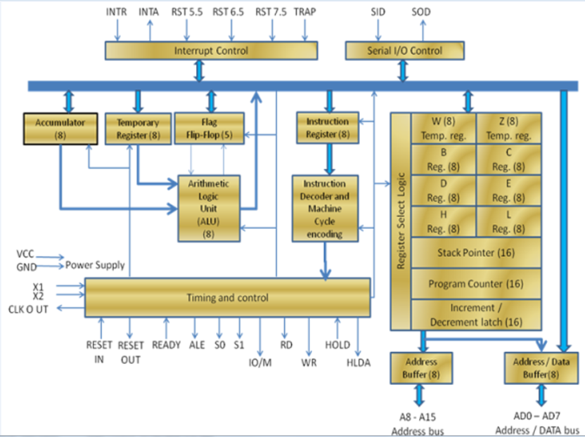
8085 Microprocessor: A brief study
Accumulator
It is an 8-bit register used to perform arithmetic, logical, I/O & LOAD/STORE operations. It is connected to internal data bus & ALU.
General purpose register
There are 6 general purpose registers in 8085 processor, i.e. B, C, D, E, H & L. Each register can hold 8 bit data.
These registers can work in pair to hold 16 bit data and their pairing combination is like B C, D E & H L.
Temporary register
It is an 8 bit register, which holds the temporary data of arithmetic and logical operations.
W and Z are two 8 bit temporary registers of 8085 microprocessor, which is not accessible to the user. (non programmable)
Program counter
It is a 16 bit register used to store the memory address location of the next instruction to be executed.
Flag register
It is an 8 bit register having five 1 bit flip flops , which holds either 0 or 1 depending upon the result stored in the accumulator.
Stack pointer
It is also a 16 bit register works like stack, which is always incremented/decremented by 2 during push & pop operations. It holds the address of the top location of the stack.
Instruction register and decoder
It is an 8 bit register.
When an instruction is fetched from memory then it is stored in the Instruction register. It decodes the information present in the Instruction register.
While executing a main program and whenever an interrupt occurs, the microprocessor shifts the control from the main program to process the incoming request.
controls the serial data communication
Provides necessary signals for operation
Data bus carries the data to be stored. It is bidirectional, whereas address bus carries the location to where it should be stored and it is unidirectional. It is used to transfer the data & Address I/O

Slide 15
THANK YOU

